Slide 1
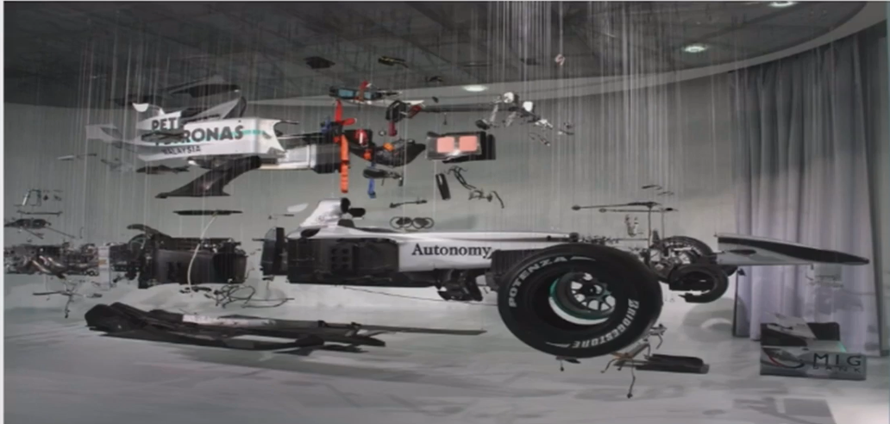
Automotive components

Slide 2
Vehicle subsystems
Chassis
Bodywork
PowerTrain
Suspension System
Steering System
Braking System
Electronics system

Slide 3
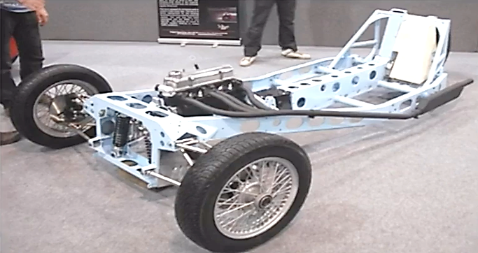
The vehicle chassis
The chassis of the vehicle Is that internal framework on which the various other different components of the vehicle will be attached thus forming the fundamental
framework of any vehicle.
Is not the entire car body!
Forms the base of the entire vehicle!
Needs to have very high
strength and rigidity!

Slide 4
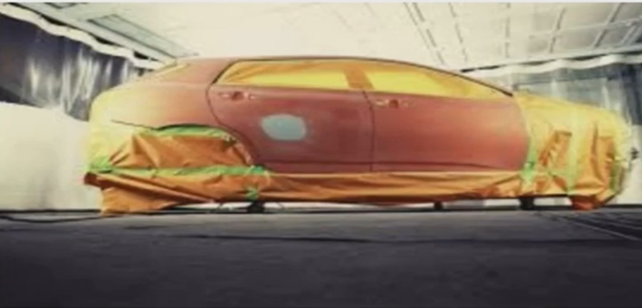
Bodywork
Is the outer covering of the vehicle which takes care of a number of non-operational aspects.
The body work takes
Care of the aesthetic appeal.
The body work takes care of the
Aerodynam ics of the vehicle

Slide 5
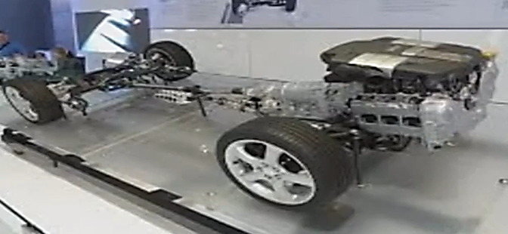
PowerTrain
Is responsible for the transmission of the power from the power unit to the wheels of the vehicle. It consists of a large number of different components.
The main component is the power unit which delivers the power to be used.
The engine is the power unit followed by a number of other transmission components

Slide 6
PowerTrain
Main components of the Power Train system
Power Unit or engine
The power unit which is mostly the engine or battery for the vehicle is the one which delivers the power to drive and run the vehicle.
Transmission shafts
Transmission shafts deliver the power from the power units to the gear boxes and ultimately to the wheels of the vehicle
Gearbox and differentials
The gearbox is responsible for reducing or increasing the torque or RPM of the transmissions shafts as and when needed.
Axles and joints
The axles are responsible for transmitting power from the gearbox to the wheels and joints are used for transmitting power between different shafts and the axles.

Slide 7
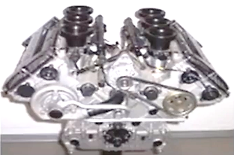
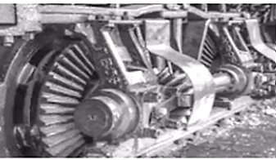
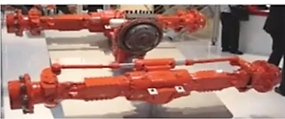
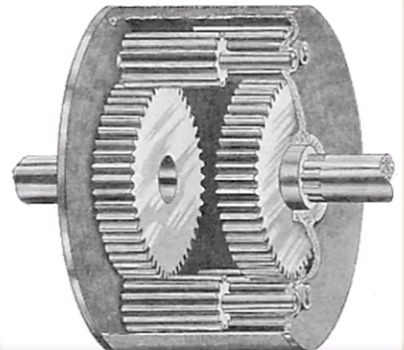
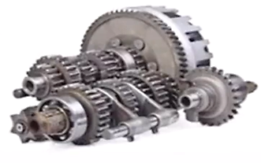
PowerTrain

Slide 8
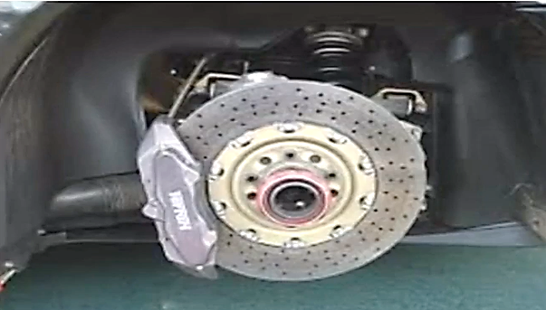
Braking System
The braking is responsible for providing the stopping forces
which can make sure that the vehicle does not undergo
any accidents or risky dynamics.
The braking system also consists of a number of
smaller components which are assembled together
The braking system also govern the dynamics of a
vehicle in certain situations.

Slide 9
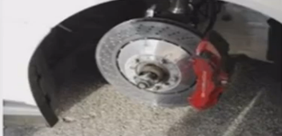
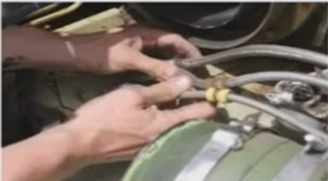
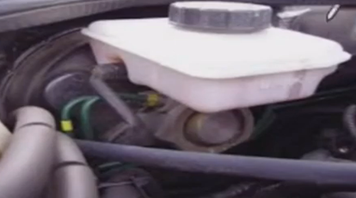
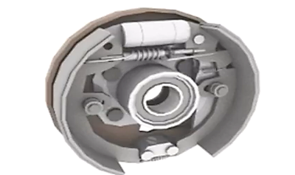
Braking System

Slide 10
Electronics systems
The electronics system takes care of a lot of different subsystems and integration of the various electro- mechanical systems.
The electronics system is also used in automotive entertainmentsystems
The majority of the electronics systems are used for control of various electro- mechanical components

